Slide 1
Java SE Additional
Standard Edition

Slide 2
Design Patterns
Creational
Structural
Behavioural
Design patterns represent the best practices developed and used by experienced OO software developers.
In general they are solutions to common problems that developers faced during development.
Think of them as ‘Templates’ that you can use to make your code more efficient/effective.
Creational Patterns are centred around the creation of objects while hiding the logic behind the creation. The aim of this is to give the program greater flexibility in deciding which objects are needed for a given case.
Structural design patterns focus on the way the classes and objects are structured. The aim of this if to use inheritance and interfaces to define the composition of objects for new functionality.
Behavioural patterns are focused on the communication between objects.
Notes:
Represent best practice
Solutions to common problems/issues
You don’t need to know them all, just know they exist and that they are something you can refer to later.
If you encounter a problem you don’t know how to solve, there may be a design pattern for it
Finally, when you are deployed you may be asked by your design lead to create a piece of software utilising a particular design pattern which you have not yet seen.

Slide 3
Builder Pattern
Builder pattern solves the issue where the amount of parameters that an object requires leads to an exponential amount of constructors
(To enable every combination between the parameters)
How the builder pattern solves this problem is by using default values and being able to return/fill a constructor at every step.
Builder pattern is an object creation software design pattern, intention of it is to find a solution to the telescoping constructor anti-pattern which occurs when the increase of parameters for constructors leads to an exponential list of constructors.
Instead of using numerous constructors the builder pattern uses another object, a builder, that receives each parameters step by step then returns the resulting constructed object at once.
Notes:
An example where the number of constructor increases exponentially/
For example in a class with 3,4,5 attributes that increases as the project progresses.
Constructors will have many values, many Strings, how would you call constructor with just one String, which one would it be, why?

Slide 4
Builder Pattern - Example
public class TraineeBuilder {
private String name;
//we dont want a default name.
private int age = 0;
//default age
private String technology = "nothing"; //default technology
public TraineeBuilder(){}
public Trainee buildTrainee()
{
return new Trainee(name,age,technology);
}
public TraineeBuilder name(String _name)
{
this.name = _name;
return this;
}
}
public class Trainee {
private String name;
private int age;
private String technology;
Trainee(String name, int age, String technology)
{
this.name = name;
this.age = age;
this.technology = technology;
}
}
Notes:
What if I added more parameters?
Exponential increase in number of constructors

Slide 5
Builder Pattern - Example
public TraineeBuilder age(int _age)
{
this.age = _age;
return this;
}
public TraineeBuilder technology(String _technology)
{
this.technology = _technology;
return this;
}
Trainee t1 = new TraineeBuilder().name("connor").buildTrainee();
Trainee t2 = new TraineeBuilder().name("jeff").age(12).technology("devops").buildTrainee();
Notes:
So here we get a really tidy one liner that basically lets you put as many or as little parameters as you want to use for that object, in the first example we just give it a name and in the second we fill everything in
How this works is that when we create our trainee builder, after the brackets we can then call the method name() which returns the traineebuilder, so then on that instance of trainee builder we can call the method age() and so forth, until we want it to return type of Trainee which we then call buildTrainee() and that is the object that is assigned to “t2” in this case, our trainee.
Called method chaining
Effectively these methods are setters

Slide 6
Other Patterns
Creational
Structural
Behavioural
Factory Pattern
Abstract Factory Pattern
Singleton Pattern
Builder Pattern
Prototype Pattern
Adapter Pattern
Bridge Pattern
Filter Pattern
Composite Pattern
Decorator Pattern
Flyweight Pattern
Proxy Pattern
Chain of Responsibility Pattern
Interpreter Pattern
Iterator Pattern
Mediator Pattern
Memento Pattern
Observer Pattern
State Pattern
Null Object Pattern
Strategy Pattern
Template Pattern
Visitor Pattern
Notes:
Know how to research and implement them if when you are deployed you are asked to follow a particular pattern

Slide 7
Exceptions
An exception is something that occurs during the execution of a program that disrupts the normal flow of instructions.
Every system is going to have errors that occur at some point, Error handling is the way in which we prevent the system from terminating unexpectedly, aka handling the errors in a desirable way.
There are 2 different type of exceptions
Checked – An exception that is noticed by the compiler
Unchecked – An exception that isn’t noticed by the compiler.
Notes:
- Printer example
An exception is an exceptional circumstance
Some Exceptions you may have already come across are:
concurrent modification
Null pointer exception
arrayindexoutofbounds

Slide 8
Checked Exceptions
Compile time
Where we can anticipate an exception ahead of time and plan for it
Exception is the parent class of all Checked Exceptions
FileNotFoundException
SocketException
UnsupportedDataTypeException
ClassNotFoundException
NoSuchMethodException
NoSuchFieldException
Notes:
https://docs.oracle.com/javase/7/docs/api/java/io/IOException.html

Slide 9
UnChecked Exceptions
Runtime issues (When the code is being ran)
Caused by bad programming
E.g. trying to address an array at a point that is larger than the arrays size
RuntimeException is the parent class of all unchecked exceptions.
If we are throwing a RuntimeException (or any subclass of it) in a method, it’s not required to specify them in the signatures throw clause.
ArrayIndexOutOfBoundsException
ClassCastException
NullPointerException
NumberFormatException
IllegalArgumentException
Notes:
http://docs.oracle.com/javase/7/docs/api/java/lang/RuntimeException.html

Slide 10
Errors
Subclass of Throwable.
Indicates a serious problem that an application should not try to catch
VirtualMachineError
ThreadDeath
OutOfMemoryError
CoderMalfunctionError
Notes:
http://java.sun.com/javase/6/docs/api/java/lang/Error.html

Slide 11
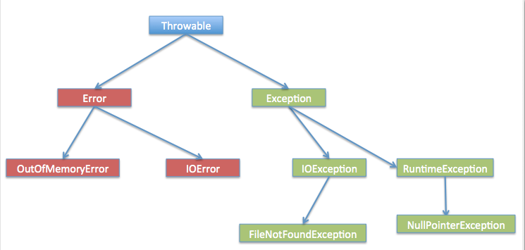
Exception Hierarchy

Slide 12
Common Exceptions
Type | Name | Description
Checked | ClassNotFoundException | Thrown when a class cannot be loaded due to a failure to locate its definition.
Checked | NoSuchMethodException | Thrown when a method is unable to be located.
Checked | IOException | Thrown when a input/output operation occurs.
Checked | SQLException | Thrown when database error occurs.
UnChecked | ArrayIndexOutOfBoundsException | Array is accessed with an illegal index that is >,< or = to the size of the array.
UnChecked | IndexOutOfBoundsException | Exception is thrown when an index is out of range.
UnChecked | NullPointerException | Occurs when a objects is needed but a null is found.
Error | ExceptionInInitializeError | When an unexpected exception occurs in a static initializer.
Error | OutOfMemmoryError | Thrown when garbage collection is performed but it was unable to free up memory.

Slide 13
Common Exceptions 2
Thrown By | Name | Description
JVM | ClassCastException | Thrown when attempting to cast a reference variable to a type that fails the IS-A test.
Programmatically | IllegalArgumentException | Thrown when a method receives an argument formatted differently than the method expects
Programmatically | IllegalStateException | Thrown when the state of the environment doesn’t match the operation being attempted – for example using a scanner that’s been closed.
Programmatically | NumberFormatExcepton | Thrown when a method that converts a String to a number receives a String that it cannot convert
JVM | ArrayIndexOutOfBoundsException | Thrown when attempting to access an array with an invalid index value (either negative or beyond the length of the array)
Programmatically | AssertionError | Thrown when an assert statements boolean test returns false.
JVM | NullPointerException | Thrown when attempting to invoke a method on, or access a property from, a reference variable whose current value is null.
Programmatically | ExceptionInInitializeError | Thrown when an assert statements boolean test returns false
JVM | StackOverflowError | Thrown wen attempting to initialize astatic variable or an initialization block
JVM | NoClassDefFoundErrror | Thrown when the JVM cant find a class it needs, because of a command-line error, a classpath issue, or a missing .class file

Slide 14
Handling Exceptions
You can have
Catch and no finally.
Catch with a finally.
Multiple catches and no finally.
Multiple catches with a finally.
try {
// The System will try to run this // code
} catch(ExceptionType name) {
// If an exception occurs in the try // block that matches the // ExceptionType of the catch // statement, this block will run
} finally {
// This is code that will always run // regardless of whether or not an // exception was thrown
}
Notes:
Work an example
Arithmetic exception example

Slide 15
Handling Exceptions - Example
You can use multiple catch statements to handle specific exceptions.
Be careful when doing this as the compiler will throw an exception for unreachable code if you try to catch an exception that has already been caught by a previous catch.
} catch (InputMismatchException imx) {
// TODO: handle exception
} catch (IOException ioe) {
// TODO: handle exception
} catch (Exception e) {
// TODO: handle exception
}

Slide 16
Handling Exceptions– Further Example
This method is designed to take an integer off a user.
sc.nextInt(); will throw a “InputMismatchException” if they enter something that isn’t an integer
So we can surround this in a try/catch block to handle that error
int takeInput()
{
Scanner sc = new Scanner(System.in);
int input = -1;
try{
input = sc.nextInt();
}
catch(InputMismatchException ime)
{
System.out.println(ime.toString());
}
return input;
}

Slide 17
The Throws Clause
If a Checked exception is thrown in a method, whatever is calling that method must handle it in some way.
One way is to surround it with a try/catch
Another way is to add another throws clause onto the method.
“method2” in this case could be a method inside of an IO Class that expects an IOException to be thrown, and thus needs to be handled.
public static void main(String[] args) {
method1();
}
static void method1() {
method2();
}
static void method2() {
throw new IOException();
}
Notes:
In this example the error will be in method2 saying that an exception isn’t being handled.

Slide 18
Working with errors
public static void main(String[] args) {
method1();
}
static void method1() {
method2();
}
static void method2() throws IOException {
throw new IOException();
}
public static void main(String[] args) {
method1();
}
static void method1() throws IOException {
method2();
}
static void method2() throws IOException {
throw new IOException();
}
Notes:
First example error will be in method1() on the method2() call saying an exception is unhandled
Second example will be an error in main on the method1() call saying an exception is unhandled.

Slide 19
Working with errors
public static void main(String[] args) throws IOException {
method1();
}
static void method1() throws IOException {
method2();
}
static void method2() throws IOException {
throw new IOException();
}
public static void main(String[] args) {
try {
method1();
} catch (IOException io) {
System.out.println(io.toString());
}
}
static void method1() throws IOException {
method2();
}
static void method2() throws IOException {
throw new IOException();
}
Notes:
Both examples will compile however in the first example the error will never be handled/caught, whilst in the second it will be.

Slide 20
Exceptions & Inheritance - Rules
An overriding method (sub/child) can throw any unchecked exceptions, regardless of whether the overridden method (super/parent) throws exceptions or not.
However the overriding method (sub/child) should not throw checked exceptions that are new or broader than the ones declared by the overridden method (super/parent)
The overriding method (sub/child) can throw those checked exceptions which have less scope than the exceptions declared in the overridden method (super/parent)
If a constructor is throwing an exception then any subclasses of that class must also throw the same Exception.
Notes:
Introduce the idea of a stack
LIFO
Generally about functions
Arithmetic Exception Example
public static void main(String[] args) {
// TODO Auto-generated method stub
System.out.println(divideNum(2, 0));
}
public static int divideNum(int a, int b) {
int c = 0;
try {
c = a / b;
return 1;
} catch (ArithmeticException ex) {
return 2;
} finally {
}
}
​

Slide 21
SOLID
The five basic principles of Object Orientated Programming/Design
Following these will lead your system easier to maintain and extend over time.
Part of an overall strategy of agile and Adaptive software Development
Single Responsibility Design
Open/Closed Principle
Liskovs Substitution Principle
Interface Segregation Principle
Dependency inversion Principle
Notes:
Best practice for designing your classes

Slide 22
S – Single Responsibility Principle
“One class should have one and only one responsibility”
If it is a model class then it should strictly represent only one actor/entity
If it’s a service/manager class then it should only contain the method calls that work on X model class.
Imagine you have a userManagement class, when you create a new user you need to send a welcome email.
This should be in two classes! One for creating a user, which then sends an event to an emailservice class.
Classes that are hard to unit test are often breaking this rule.
Notes:
https://github.com/mikeknep/SOLID/tree/master/single_responsibili
In other words, you should write, change and maintain a class for only one purpose. If it is model class then it should strictly represent only one actor/ entity. This will give you the flexibility to make changes in future without worrying the impacts of changes for another entity.

Slide 23
O – Open/Closed Principle
“Software components should be open for extension, but closed for modification“
Classes should be designed in such a way that when a fellow developer wants to change the flow of control in specific areas, all they need to do is extend your class and override some functions and that’s it.
A bad example of this would be having a switch statement which functions as your menu, and having to add another case every time you want a new menu option.
Notes:
https://github.com/mikeknep/SOLID/tree/master/open_closed
The bad example is us not following the O principle

Slide 24
L – Liskovs Substitution Principle
Imagine having an Bird class with a fly() and eat() method.
Every class that extends Bird should implement the fly() and eat() methods,
But something that could ruin this principle would be to create a class such as Ostrich, which throws a UnsupportedOperationException.
This violates this principle.
We don’t want to have to check every subclass to see if it works before using it, it should just work.
To fix this issue we could use factoring, sometimes filtering out the common features into a separate class can help.
“Derived types must be completely substitutable for their base types”
Any classes a fellow developer create by extending your class should be able to fit into an application without failure.
This can generally be insured by following the first rule, if your class is only doing one thing then worst case only one thing should break, not your entire application.
Notes:
https://github.com/mikeknep/SOLID/tree/master/liskov_substitution
So in this example we could create flightBirds and nonFlightBirds

Slide 25
I – Interface Segregation Principle
“Clients should not be forced to implement unnecessary methods which they will not use.”
E.g. You create an interface called Reportable that has two methods called generateExcel() and generatePDF().
Now client A wants to use this interface but actually only intends to use the generatePDF() function.
He has to either implement generateExcel() or have an empty method, either one is undesirable in this situation.
The solution would be to split it up into ExcelReportable and PDFReportable
Notes:
https://github.com/mikeknep/SOLID/tree/master/interface_segregation

Slide 26
D – Dependency Inversion Principle
“Depend on abstractions, not on concretions.”
You should design your software so that various modules can be separated from each other using an abstract layer to bind them together.
A real life example would be when you buy something with your credit card, the cashier doesn’t look at your card and bring out say a Visa machine because you have a visa card, just a generic one that works with all credit cards.
Notes:
https://github.com/mikeknep/SOLID/tree/master/dependency_inversion

Slide 27
Testing
Testing is Highly Important.
Within Testing we have Methods, Levels, Types and Methodologies.
Methods include White-Box and Black-Box Testing.
Levels include Unit and Acceptance Testing.
Types include Functional and Non-Functional
Methodologies include Top-Down and Bottom-Up.
In Test Driven Development you Test First, Code Later.
Unless a test fails, you don’t code.
If no test fails, write more tests.
The result is that all code is covered by tests.
All code conforms to the design specification and
Problems are caught sooner and fixed cheaper.

Slide 28
Unit Testing
Unit testing is all about ensuring that a specific piece of code works.
To do this you create Test Classes.
Test Classes hold all of the tests for a specific class and are in charge of setting up and tearing down the class and any other classes that are required to test the class in question.
Test Classes are run from a Test Suite class.
Junit is what we’ll be using for our Unit tests.

Slide 29
JUnit Test Methods
assertTrue(“Boolean was False”, Boolean)
assertFalse(“Boolean was True”, Boolean)
assertEquals(“Actual was not Expected”, Expected, Actual)
assertEquals(“Actual was not expected within the Tolerance”, Expected, Actual, Tolerance)
fail(“Method Failed the Test”)
assertNull(“The object is not Null”, Object)
assertNotNull(“The object is Null”, Object)
assertSame(“The objects are not the same”, Expected, Actual)
assertNotSame(“The objects not the same”, Expected, Actual)
Notes:
So the message here is what the test should print out when the test fails

Slide 30
JUnit
import static org.junit.Assert.*;
import org.junit.Test;
public class AuthorTest {
@Test public void testAuthor() {
Author testing = new Author();
assertNull(testing.getName());
}
@Test public void testAuthorString() {
Author testing = new Author("a");
assertNotNull(testing.getName());
}
@Test public void testSetName() {
Author testing = new Author();
testing.setName("a");
assertEquals("a", testing.getName());
}
Junit might be already installed on your system, if not search for Junit download 4.0.
Once you have access to the .jar file, go to your project, right click -> properties -> java build path -> libraries -> add external jar, then add your junit jar file.
Once installed simply create a ‘junit test case’.
I’d advise having all your tests in a separate package, naming your tests after the class they’re testing.

Slide 31
java.IO
IO = Input/Output
Java refers to IO as a ‘stream’
An IO stream represents an input source or an output destination
A stream can represent different kinds of sources and destinations
Files, devices
Other Programs
Memory Arrays
Websites
Streams can support many different types of data.
Primitive data types
Strings
Streams simply pass on data, or manipulate/transform the data into different types of data.
E.g. you could read in bytes from a file but then process it as a String, then write it back as bytes.

Slide 32
The two main categories of data streams
A developer typically uses input and output in 3 ways
To interact with files and directories
To read from and write to the console (Standard-in and Standard-out)
Using ‘socket’ based sources to communicate with a remote system
Base class names (you use classes that derive from these)
For byte streams – InputStream & OutputStream
For character streams – Reader & Writer
Java supports two types of streams: character and byte.
‘Readers’ and ‘Writers’ handle ‘character’ data.
Input & Output streams handle ‘byte’ data
Typically we say stream to refer to a byte stream.
Say reader and writer to refer to (Unicode) character streams.

Slide 33
Byte Stream - Example
This simple example copies the contents of one file to another file just using a byte array 128 at a time.
Then the odd few at the end (assuming total length of bytes read in is not an exact multiple of 128).
import java.io.*;
public static void copy(String inFile, String outFile) throws IOException {
byte[] bytes = new byte[128];
FileInputStream fis = new FileInputStream(inFile);
FileOutputStream fos = new FileOutputStream(outFile);
int count = 0, read = 0;
while ((read = fis.read(bytes)) != -1) {
fos.write(b, 0, read); // mainly 128 at a time
count += read;
}
System.out.printf("Wrote: %d bytes\n ", count);
fis.close();
fos.close();
}

Slide 34
Buffered Reader - Example
BufferedReader chained to a FileReader but notice the read requests issued to the high level BufferedReader, mirrored by the BufferedWriter using the FileWriter.
public static void bufferedcopy(String inFile, String outFile) throws IOException
{
BufferedReader bfrIn = new BufferedReader(new FileReader(inFile));
BufferedWriter bfwOut = new BufferedWriter(new FileWriter(outFile));
String line = "";
while ((line = bfrIn.readLine()) != null) {
bfwOut.write(line + "\n");
}
bfrIn.close();
bfwOut.close();
}

Slide 35
JDBC
The JDBC API allows us to connect to SQL databases from our Java applications.
Using a JDBC driver, with the location of the database and the credentials for accessing that database we can query the database for data and perform the CRUD functions.
public class JDBCExample
{
static final String JDBC_DRIVER = "com.mysql.jdbc.Driver";
static final String DB_URL = "jdbc:mysql://localhost/dbexample";
static final String USER = "username";
static final String PASS = "password";

Slide 36
Opening a connection
The first thing we need to do is open the connection to the database.
public void accessDB() {
Connection conn = null;
Statement stmt = null;
…
Class.forName(“com.mysql.jdbc.Driver”);
System.out.println(“Connecting to database...”);
conn = DriverManager.getConnection(DB_URL, USER, PASS);
…

Slide 37
C - Create
This block of code will create a new entry into the table Languages using the connection we opened earlier.
First it will create a statement,
Then it will take the SQL query as a String.
Finally it will Execute that query.
System.out.println(“Inserting records into the table...”);
stmt = conn.createStatement();
String sql = “INSERT INTO Languages “ + “VALUES (1, 'Java', 1992)”;
stmt.executeUpdate(sql);
System.out.println(“Inserted records into the table...”);

Slide 38
R - Read
System.out.println("Creating statement...");
stmt = conn.createStatement();
String sql2 = "SELECT id, name, date FROM Languages";
ResultSet rs = stmt.executeQuery(sql2);
while (rs.next()) {
int id = rs.getInt("id");
String name = rs.getString("name");
int date = rs.getInt("date");
System.out.println("ID: " + id + ", name: " + name + ", date: " + date);
}
rs.close();
Notes:
This block of code will read all entries in the table Languages using the connection we opened earlier and print the results.
First it will create a statement,
Then it will take the SQL query as a String.
After that it will Execute that query.
Finally it will loop through all results, printing them to the console.

Slide 39
U - Update
This block of code will update an existing entry in the table Languages using the connection we opened earlier.
First it will create a statement,
Then it will take the SQL query as a String.
Finally it will Execute that query.
System.out.println(“Creating statement...”);
stmt = conn.createStatement();
String sql3 = “UPDATE Languages “ + “SET date = 1994 WHERE id in (1, 2)”;
stmt.executeUpdate(sql3);

Slide 40
D - Delete
This block of code will delete an entry in the table Languages using the connection we opened earlier.
Be careful with the delete operation as you can easily delete the wrong entry by mistake.
First it will create a statement,
Then it will take the SQL query as a String.
Finally it will Execute that query.
System.out.println(“Creating statement...”);
stmt = conn.createStatement();
String sql4 = “DELETE FROM Languages ” + “WHERE id = 1”;
stmt.executeUpdate(sql4);

Slide 41
Closing the connection
The last thing we need to do is close the connection to the database.
We will catch all of the exceptions that may be thrown.
We will then check that the connections are open and if so, close them.
} catch (SQLException sqle) {
sqle.printStackTrace();
} catch (Exception e) {
e.printStackTrace();
} finally {
try {
if (stmt != null)
conn.close();
} catch (SQLException se) { }
try {
if (conn != null)
conn.close();
} catch (SQLException se) {
se.printStackTrace();
}
}
System.out.println(“Goodbye!”);

Slide 42
Logging
Logging is used to keep a history of system related messages during the operation of a system.
The Java.util.Logging package contains the classes associated with logging including the Level class which is used to define the lowest severity of messages which should be written to the log.
The Levels of severity are:
Severe – The world is ending
Warning – Mild Panic
Info – Things you may need to know
Config – Deployment information
Fine – Debugging information
Finer – Things you may need to know
Finest – Nitty-gritty details

Slide 43
Logging - Handlers
Loggers work by utilising handlers to output their data in the appropriate location.
You can also create your own handlers from scratch or even just re-write some of the existing ones to better suit your application.
The Types of Handlers are:
StreamHandler: A simple handler for writing formatted records to an OutputStream.
ConsoleHandler: A simple handler for writing formatted records to System.err
FileHandler: A handler that writes formatted log records either to a single file, or to a set of rotating log files.
SocketHandler: A handler that writes formatted log records to remote TCP ports.
MemoryHandler: A handler that buffers log records in memory.

Slide 44
Logging - Formatters
Loggers output according to formatters that are applied to them.
Java SE provides two standard Formatters
Like with handlers, you can develop your own formatters easily.
The Types of Formatters are:
SimpleFormatter: Writes brief "human-readable" summaries of log records.
XMLFormatter: Writes detailed XML-structured information.

Slide 45
Logging - Example
public class testLog {
private static Logger logger = Logger.getLogger(testLog.class.getName());
public void SomeMethod(){
FileHandler fh;
try {
//create a file handler with a text path
fh = new FileHandler("mylog.txt");
//Assign it a simple formatter (or xml, or custom)
fh.setFormatter(new SimpleFormatter());
logger.addHandler(fh);
//set the level at what you want it to output at.
//could be 'ALL' if you wanted to output everything
logger.setLevel(Level.FINE);
logger.log(Level.FINE, "Cool stuff");
//Does the same as the previous line
logger.fine("Cool Stuff");
} catch (Exception e) {
logger.severe("Error!!" + e.toString());
}
Each class will need its own logger as the level of granularity needed in the logs will change from class to class.
Typically a static Logger will be created in each class as each instance will use the same logger.

Slide 46
Swing
Swing is a library that contains a group of libraries for building GUI’s and adding graphical functionality and interactivity to Java applications.
Over the next few slides we will create a simple Swing Application to show you how to work with Swing.
We will be using two libraries: javax.swing and java.awt.event and will cover JFrames and Jpannels.
Within the main class of a new project we need to extend JFrame.
JFrame, which is contained within the Swing API allows us to create new windows with Java code.
With our Main and Constructor methods we will specify two methods we need to implement.

Slide 47
Swing Application GUI
public class SwingAppGUI extends JFrame {
private JFrame mainFrame;
private JLabel headerLabel;
private JLabel statusLabel;
private JPanel controlPanel;
public SwingAppGUI() { prepareGUI(); }
public static void main(String[] args) {
SwingAppGUI sD = new SwingAppGUI();
sD.showEvent();
}
The Prepare GUI method is responsible for setting up the window.
This involves setting the size, name and layout of the window as well as size and position of the components we will later add to it.
private void prepareGUI() {
mainFrame = new JFrame("Java SWING Examples");
mainFrame.setSize(400, 400);
mainFrame.setLayout(new GridLayout(3, 1));
headerLabel = new JLabel("", JLabel.CENTER);
statusLabel = new JLabel("", JLabel.CENTER);
statusLabel.setSize(350, 100);

Slide 48
PrepareGUI()
We can also specify what happens when we press the “x” button in the top right corner.
We will then setup the JPanel and add the components to the Jframe.
mainFrame.addWindowListener(new WindowAdapter() {
public void windowClosing(WindowEvent windowEvent) {
System.exit(0);
}});
controlPanel = new JPanel();
controlPanel.setLayout(new FlowLayout());
mainFrame.add(headerLabel);
mainFrame.add(controlPanel);
mainFrame.add(statusLabel);
mainFrame.setVisible(true);
}

Slide 49
ShowEvent()
Our next method will setup three buttons we can interact with through event listeners.
We will create the buttons and set their command actions so that we can identify which button has been pressed.
private void showEvent() {
headerLabel.setText(“Press Button");
JButton okButton = new JButton("OK");
JButton submitButton = new JButton("Submit");
JButton cancelButton = new JButton("Cancel");
okButton.setActionCommand("OK");
submitButton.setActionCommand("Submit");
cancelButton.setActionCommand("Cancel");

Slide 50
ShowEvent()
Next we can look at adding an event listener to each of them.
We will then add them to the JPanel which is used as a generic container.
Once all the buttons are added to the JPanel we will set the JFrame to visible.
okButton.addActionListener(new BCL());
submitButton.addActionListener(new BCL());
cancelButton.addActionListener(new BCL());
controlPanel.add(okButton);
controlPanel.add(submitButton);
controlPanel.add(cancelButton);
mainFrame.setVisible(true); }

Slide 51
ButtonClickListener
Our event listener should be in a separate class but for this example we will create a nested class.
Within the body of SwingAppGUI we will specify the private class BCL which will act as our event listener.
BCL will then change the displayed message based on which button we press.
private class BCL implements ActionListener {
@Override public void actionPerformed(ActionEvent ae) {
String command = ae.getActionCommand();
switch (command) {
case "OK": statusLabel.setText("OK!");
break;
case "Submit": statusLabel.setText("Submitted!");
break;
case "Cancel": statusLabel.setText("Cancel not possible");
break;
} } }

Slide 52
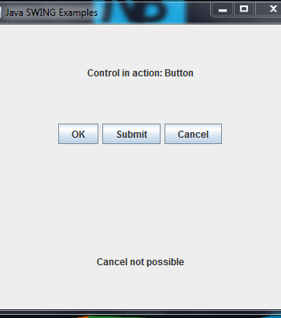
Running the Program
When you run the program you should see the following window.
You can incorporate other components into a GUI and leverage them using event listeners.
The event listeners can interact with the rest of your code to make powerful GUI’s.

Slide 53
Enums
Enumerated types are used as a clean way of storing data that has a finite number of valid values.
Enums should be defined in their own file to allow reuse across your application.
public enum Day {
MONDAY, TUESDAY, WEDNESDAY, THURSDAY, FRIDAY, SATURDAY, SUNDAY
}
----------------------------------------
public void ExampleMethod
{
Day day = Day.FRIDAY;
if(day == Day.FRIDAY){
//its friday!
}
}
Notes:
If I use “west” to denote going west in Barren Moor, it was easier to make a mistake then if I had used Day.WEST, I could mistype “wst” and the code would still compile.
Day.WST would not compile.
Benefits
Increase compile-time checking
Avoid errors from passing in invalid constants

Slide 54
Generics
Generics add stability to your code by making more bugs detectable at compile time.
If we have a method that takes an Object it will accept everything except a primitive. If at the end we cast the Object to an Integer and we are passing in a String then we get a runtime exception.
If we provide a type <T> then we allow the compiler to check for that type.
public class Cage<T>
{
private T object;
public void add(T object)
{
this.object = object;
}
public T get()
{
return object;
}
}
Notes:
In this example Cage could be a Cage for a Bird, or a Lion, make it work with whatever its presented with.

Slide 55
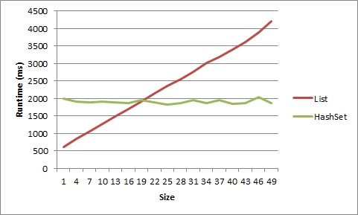
HashMaps/Hashset
HashMaps are an alternative to Normal Collections such as List implementations
Generally much faster
Necessary when you’re searching for elements a lot with LOTS of data
Unorganised
Awkward to iterate through, designed for searching for something that you know what your looking for.
A map will ‘map’ one key to a value
You will give it a key and ask for value
Notes:
A map will ‘map’ one key to a value
You will give it a key and ask for value
Get me the object that is associated with the object
Insane performance increase
- list has a linear performance decrease
Hashmap has effectively got a constant speed
We will be referring back to this linear performance with Big ‘O’ Notation later on
A set is a data structure, like an array, but cannot hold duplicates

Slide 56
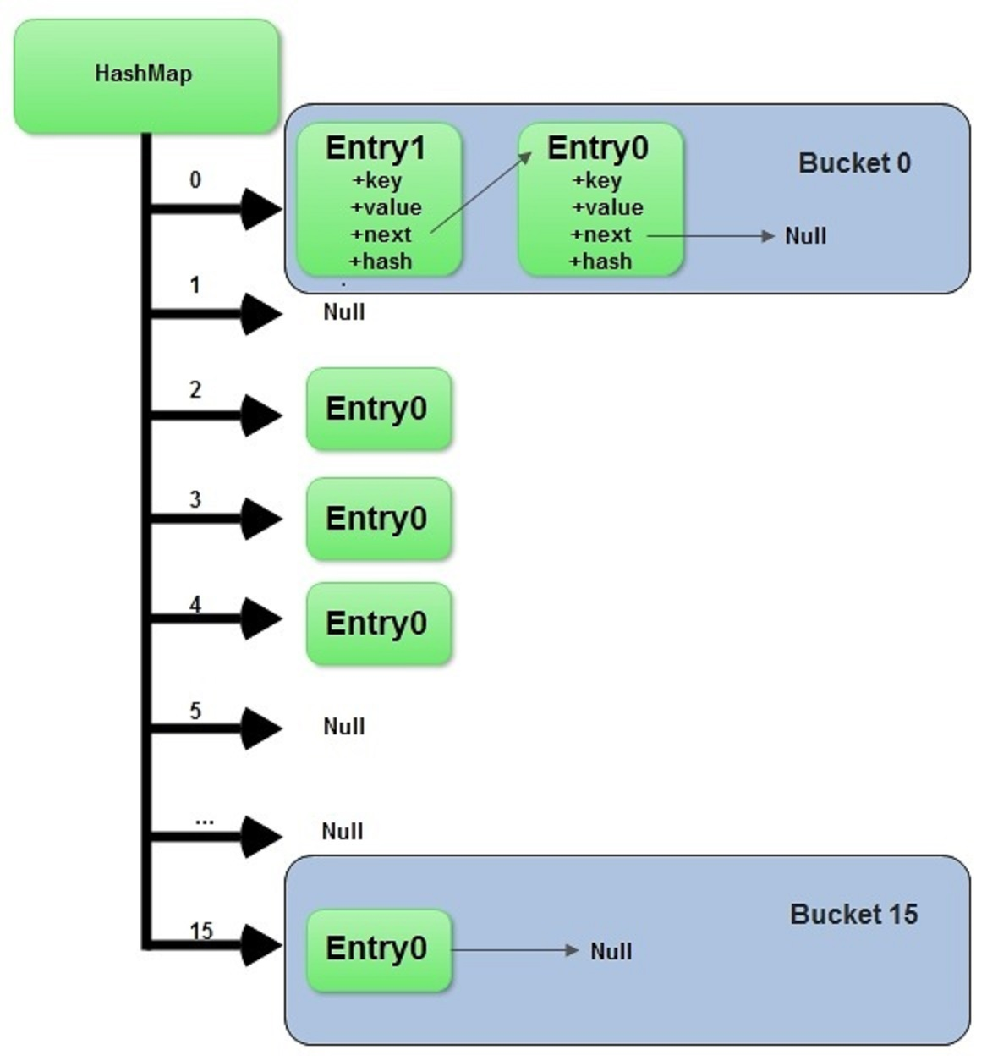
Hashmaps – How do they work?
Composed of an array of singly linked lists.
Each singly linked list is called a “Bucket”
Works on a Key/Value system
Key is what we identify the data by, value is what is associated with it.
Think of a dog care system.
E.g. the Key could be a Person object called Elliott
And the value could be a Dog object
mapName.put(elliottObject,dogObject);
These objects would then be mapped together.
So when we want to find out which dog is mine, we could retrieve that value by checking the key that is elliottObject
mapName.get(elliottObject); // would return dogObject
Notes:
When a used calls put(Key k , V value); or get(Object key)
The function computes the index of the bucket where the entry should be in
Then the function iterates through that buckets linked list and checks the hash against each item in there until it finds it, then returns the value.
The get function will return the value if the key is found
The put function will replace an existing entry with that key or create a new entry at the head of the list if not found.
The index (which bucket it will be in) is computed like so;
First it gets the hashcode of the key provided
Then it bitmasks the hashcode with the length (minus 1) of the array of linked lists, this operation ensures that the index cant be greater than the size of the array.
//takes the object in directly
static final int hash(Object key) {
int h;
return (key == null) ? 0 : (h = key.hashCode()) ^ (h >>> 16);
}
// the function that returns the index from the rehashed hash
static int indexFor(int h, int length) {
return h & (length-1);
}
It works with buckets
It computes where the object should go based upon a few things
Come out with one value
Effectively a hash
Hash can be decrypted
Passwords are hashed
Not stored as plain text
Effectively a unique identifier – and from this identifier it know which bucket it needs to go into
What this means is that say we have lots of buckets of data
It will hash the data
Can go straight there
Depending on the hashing algorithm it know exactly where to go
It knows where to go in the hash map dependant on what you give it
Usual size is 16 buckets
Maps and array lists are comparable- they can be swapped but it might be that you are using the map in the wrong way
You are supposed to give a key then return the value.
Though technically it can be used by giving a value and returning a key.
But this is not how you should be using the map
Key has to be unique
Values can be duplicated.

Slide 57
Hashmaps – Code example
HashMap<Integer, String> map = new HashMap<>();
map.put(1, "Elliott");
map.put(2, "Gareth");
map.put(12, "Dev");
System.out.println(map.get(1)); // elliott
System.out.println(map.get(11)); // null
map.put(1, "Jeff");
System.out.println(map.get(1));// jeff
Iterator<Entry<Integer, String>> it = map.entrySet().iterator();
while (it.hasNext()) {
Entry<Integer, String> entry = it.next();
System.out.println(
"Key: " + entry.getKey() + " Value: " + entry.getValue());
}
Notes:
allows the execution time of basic operations, such as get( ) and put( ), to remain constant even for large sets.
Key First, Value Second
Lots of other methods you can use – like
isEmpty()
containsKey()
ContainsValue()
Remove()

Slide 58
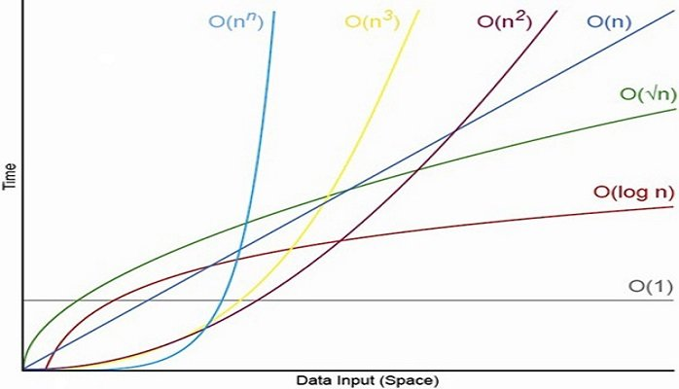
Big-O Notation
Notes:
Worst case scenario
Can be used to describe either the time required or the memory used – effectively we are looking at performance and efficiency
Log n Is that as the algorithm runs the complexity decrease, good sorting algorithms operate with a (log n) complexity
Nn is recursion

